Slide 1
Chapter 1
Introduction to Networks
Module 1: Networking Today
Introduction to Networks v7.02 (ITN)

Slide 2
Objectives
1.1 Globally Connected
1.2 Network Components and Topologies
1.3 Common Types of Networks
1.4 Internet Connections
1.5 Reliable networks
1.6 Network Trends
1.7 Issues of Network Management

Slide 3
1.1 Globally Connected
Advancements in networking technologies are helping create a world without boundaries.
The immediate nature of communications over the Internet encourages global communities.

Slide 4
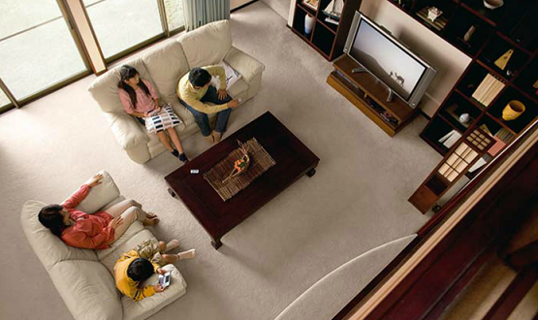

Cont’d…
Networks Support the Way We Learn
You don't have to be in school anymore to take a class.
You don't have to be in a classroom to have a teacher – distance learning
Networks Support the Way We Work
Empowered individuals to create information that can be accessed globally.
Online learning and training become more cost effective and less time consuming
Eg. Texting, Social Media, Collaboration Tools, Blogs, Wikis, Podcasting

Slide 5
Cont’d…
Networks Support the Way We Play
Eg. Online gaming, download of movies, music, e-books etc

Slide 6
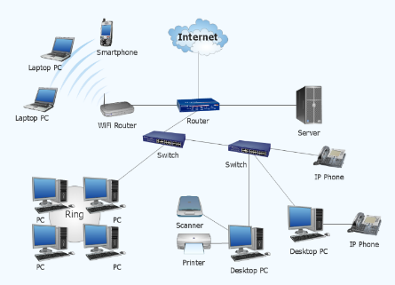

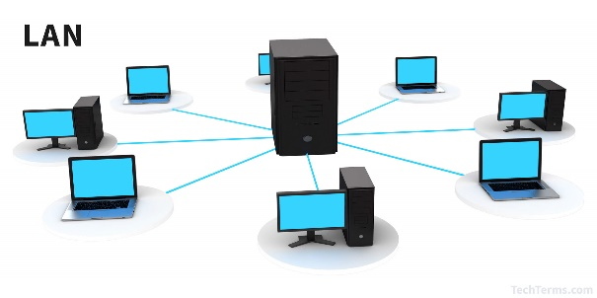
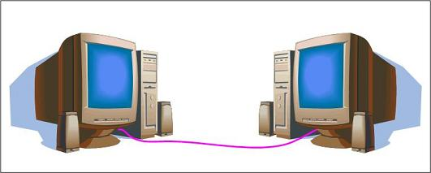

1.2 Network Components and Topologies
What is network?
A group of two or more computer systems
linked together.
Purposes of network?
To communicate, to exchange data, to share
resources

Slide 7
1.2.1 Network Components
The network infrastructure contains three categories of network components:
(i) Devices
(ii) Media
(iii) Services and Processes

Slide 8
(i) Devices
Aka network devices
They are the physical / hardware components of a
network.
There are two categories of network devices:
End devices (hosts) and
Intermediary devices

Slide 9
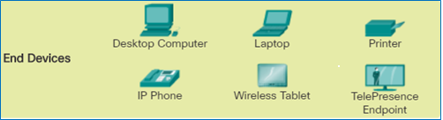
End Devices
End devices are the sender (source) / receiver
(destination) of data in a network
Eg. computer, mobile devices, printers, IP phone etc
To communicate in a network, every end device must
have an unique address

Slide 10
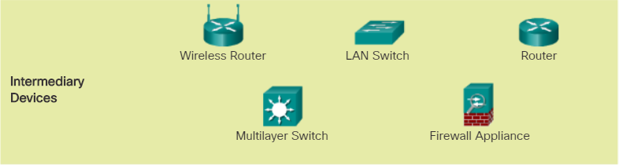
Intermediately Devices
Intermediary devices connect the end devices to the network
and can connect multiple networks to form an internetwork
Eg. switches, routers, firewalls, repeaters
Intermediately devices:
provide / extend network connectivity
regenerate signals
permit / deny data flows
route the data using the best path etc

Slide 11
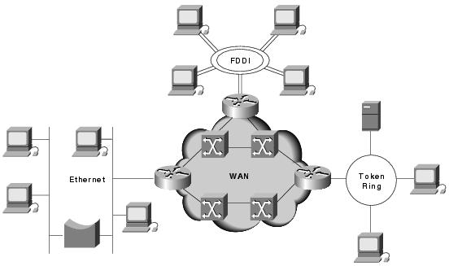
Intermediary devices
End devices

Slide 12
(ii) Network Media
aka transmission media / medium
Network media provides the channel over which
the message travels from source to destination.
appear in the form of wired / wireless
Eg. copper wire (electronic pulses), fiber optics (light pulses), waves (electromagnetic waves)

Slide 13
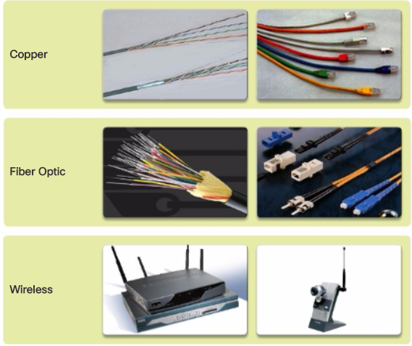
Cont’d…

Slide 14
Cont’d…
Criteria for choosing transmission media:
Distance / environment
Cost
Transmission speed
Ease of installation

Slide 15
Cont’d…
For the devices and media to be connected, the following are involved:
Network Interface Card (NIC)
provides the physical connection to the network at the PC side
Physical Port
A connector or outlet on a device where the transmission media is connected
Interface
Specialized ports on a networking device that connect to individual networks
Often, the terms port and interface are used interchangeably.

Slide 16
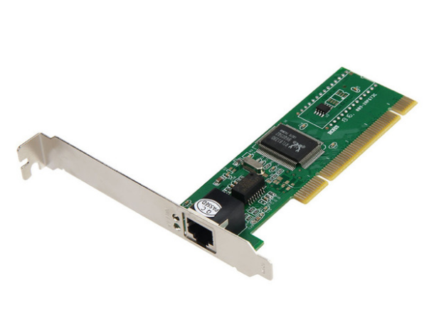
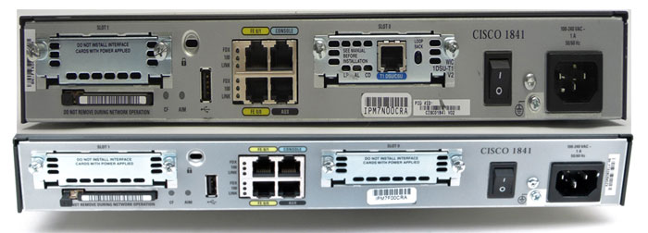
Cont’d …
NIC and its physical port
Router and
its interfaces

Slide 17
(iii) Services and Processes
Services refer to applications that run on host
computers eg. email, web hosting, DHCP, DNS
Processes refers to detail instructions / procedures that directs move the data across the network eg. regenerate and retransmit signal , error handling, routing

Slide 18
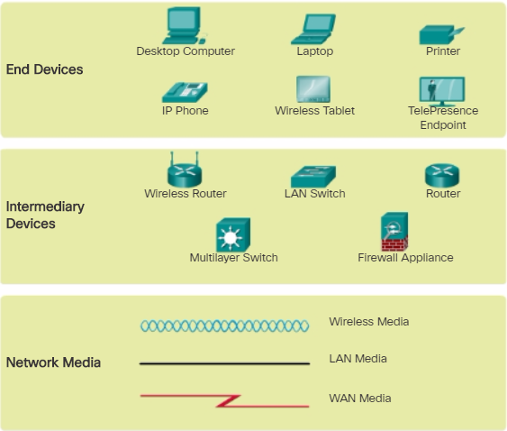
Cisco Network Representations

Slide 19
1.3 Common Types of Networks
Network infrastructures can vary greatly in
terms of:
Size of the area covered
Number of users connected
Number and types of services available
Area of responsibility
Eg. LAN, WAN, MAN, WLAN, SAN

Slide 20
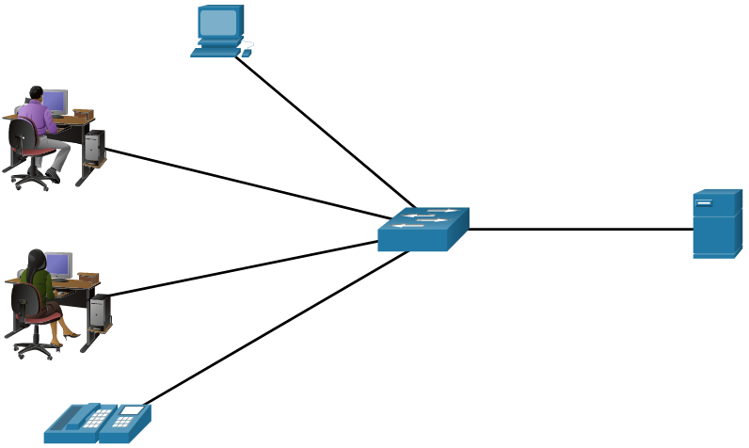
LAN and WLAN
Local Area Network / Wireless LAN
A network infrastructure that spans a small geographical area (eg. within an office building or campus)
Usually privately owned and managed (eg. individual or IT department)
LANs provide high speed bandwidth to internal end devices and
intermediary devices
Major LAN technologies are:
Ethernet
Token Ring
FDDI

Slide 21
MAN
Metropolitan Area Network
A network infrastructure that spans a physical area
larger than a LAN but smaller than a WAN (eg.
within a city)
Typically operated by a large organization

Slide 22
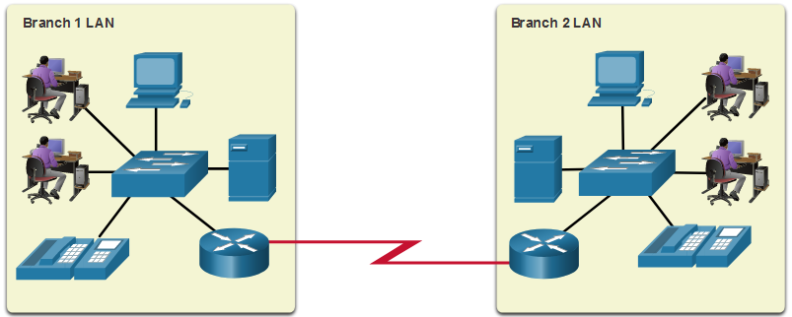
WAN
Wide Area Network
A network infrastructure that spans a wide
geographical area (eg. between cities, countries,
continents)
Broader structure from a LAN and a MAN
Typically provide slower speed links between LANs.
Typically owned and managed by the internet service providers

Slide 23

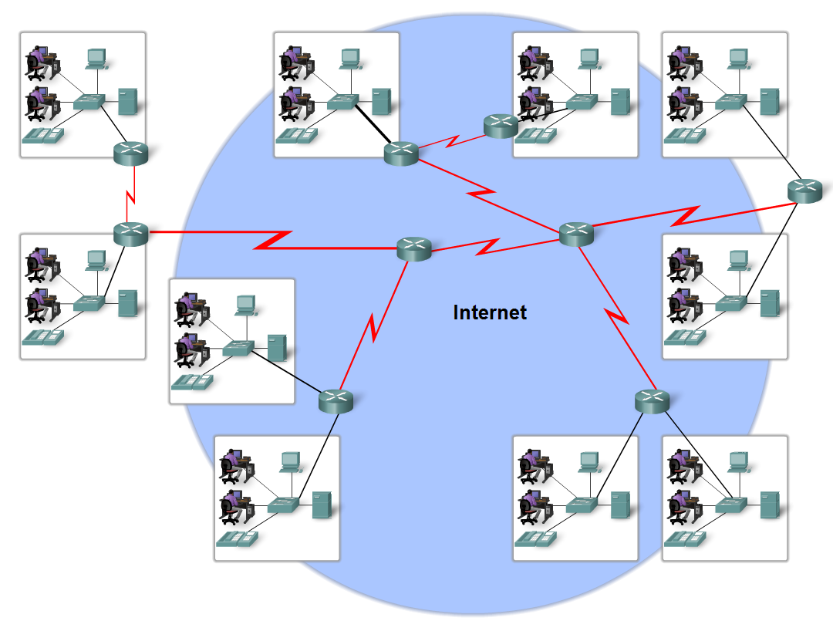
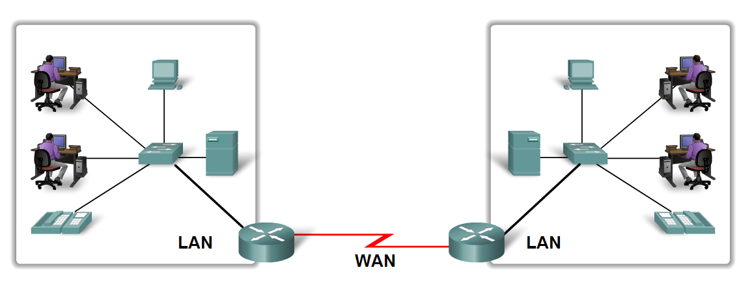
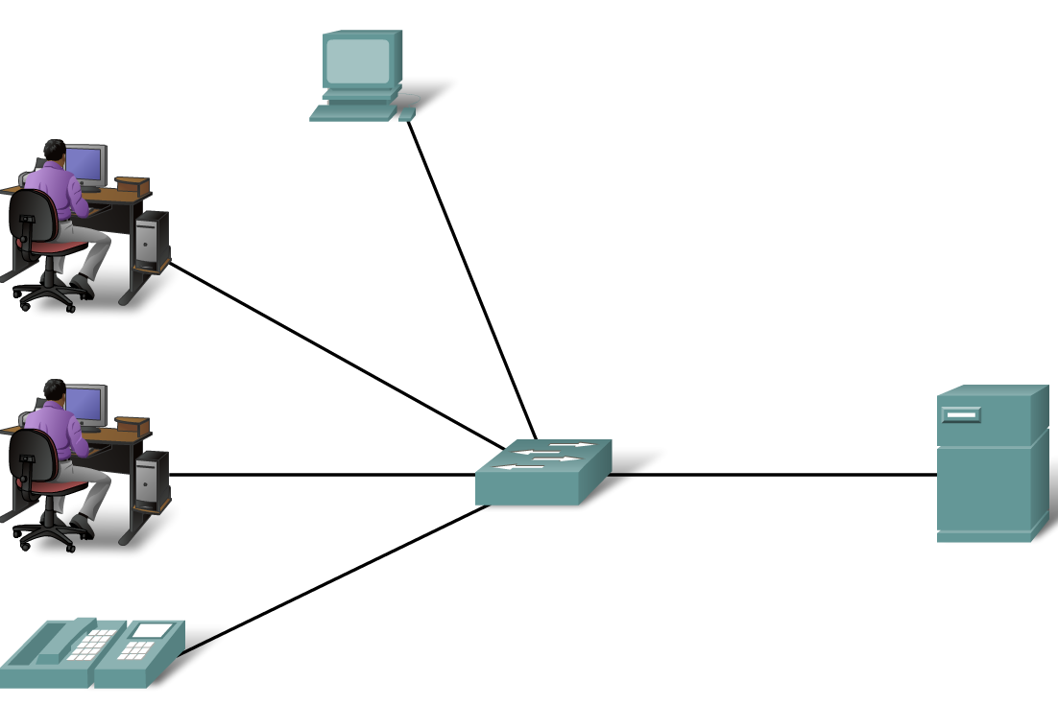
Internet
World wide collection of networks (eg. LANs,
WANs, MANs)
WAN
LAN

Slide 24
Cont’d…
The Internet is not owned by any individual or group
To ensure effective communication across this vastly diverse infrastructure, consistent and commonly recognized technologies and standards are required → Protocols
Some organizations have been developed to help in
maintaining the structure and standardization of
Internet protocols and processes. Eg.
Internet Engineering Task Force (IETF)
Internet Corporation for Assigned Names and Numbers (ICANN)
Internet Architecture Board (IAB) etc

Slide 25
Intranet
Intranet refers to a private connection of LANs and WANs that belongs to an organization, and is designed to be accessible only by the organization's members, employees, or others with authorization.
Eg. TARUC intranet system

Slide 26
Extranet
Extranet is like an intranet, but also provides controlled access to authorized customers, vendors, partners, or others outside the company.
Eg. Suppliers who have access to their customers’ extranet can use the access to track their products. They can determine whether the customer should be ready to place a new order, track previous orders, and manage their inventory appropriately so that there is no supply interruption.

Slide 27
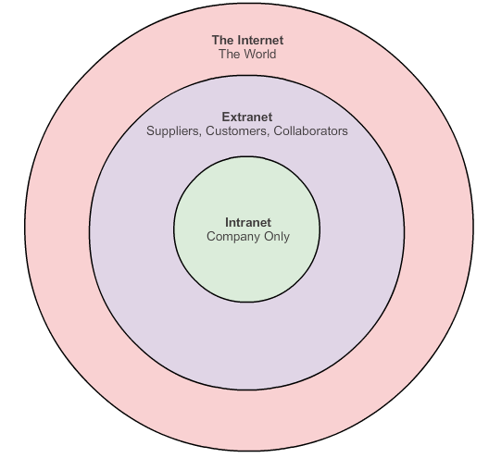
Intranet vs Extranet

Slide 28
1.4 Internet Connections
Traditional Separate Networks
Each network used different technologies, rules
and standards to carry the communication signal
Different networks are not able to communicate

Slide 29
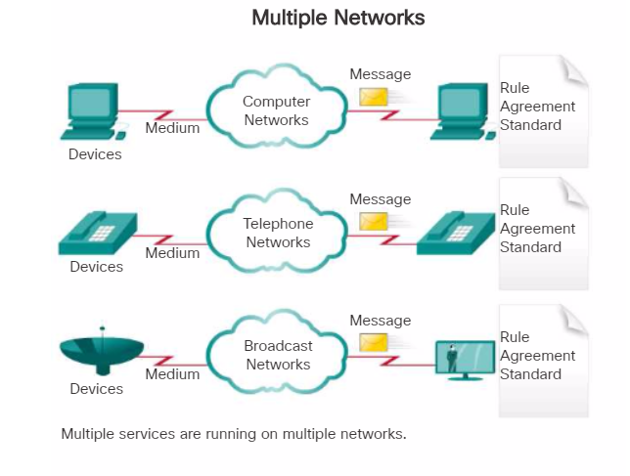
Cont’d…

Slide 30
Cont’d…
Modern Converging Networks
Unlike dedicated networks, converged networks are capable of delivering data, voice, and video between many different types of devices over the same network infrastructure
The networks convergence is made possible by
implementing the same set of rules, agreements,
and implementation standards

Slide 31
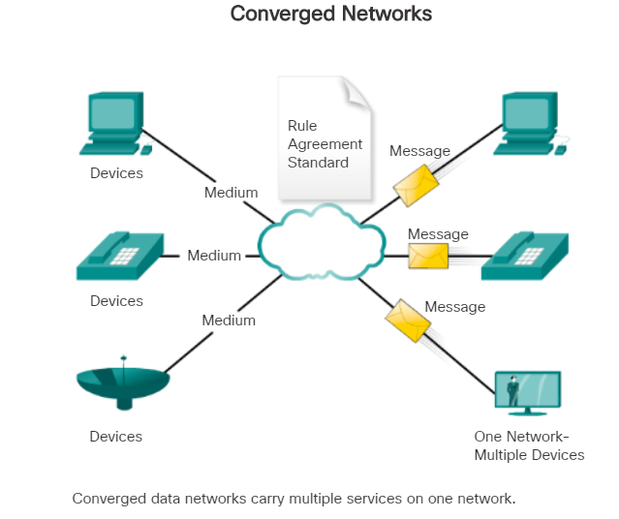
Cont’d…

Slide 32
1.5 Reliable Networks
Modern network architecture needs to meet the expectations on the following areas:
Fault Tolerance
The network must be always available
Scalability
The network must be expandable in the future
Quality of Service (QoS)
The network must be able to fulfill higher expectations for the quality of the delivered services
Security
The network infrastructure and the information stored inside must be secured

Slide 33
1.6 Network Trends
There are several new networking trends that will affect organizations and consumers.
Some of the top trends include:
BYOD
Online Collaboration
Video Communication
Cloud Computing
Smart Home Technology
Powerline Networking
Wireless Broadband

Slide 34

BYOD
Bring Your Own Devices
BYOD is about end users having the freedom to use personal tools to access information and communicate across a business or campus network eg. laptops, netbooks, tablets, smartphones, and e-readers
Extended connectivity through mobile and remote access to a network gives tremendous flexibility to the users in accessing the networks.

Slide 35

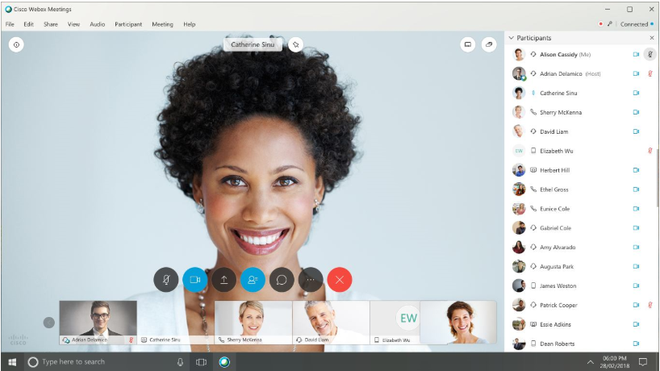
Online Collaboration
Collaboration is defined as “the act of working
with another or others on a joint project.”
For businesses, collaboration is a critical and
strategic priority that organizations are using to
remain competitive.
For students, collaboration assist each other in
learning, to develop team skills used in the work
force, and to work together on team-based
projects.
Eg. Cisco Webex, GoogleWorkspace

Slide 36
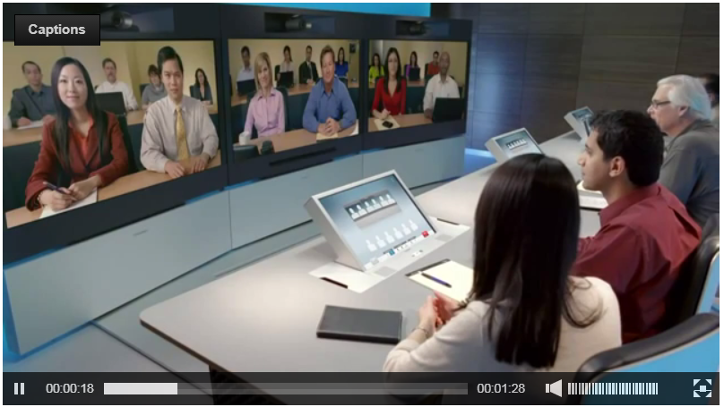
Video Communication
Video conferencing is a powerful tool for
communicating with others at a distance, both
locally and globally.
Video is becoming a critical requirement for
effective collaboration as organizations extend
across geographic and cultural.

Slide 37
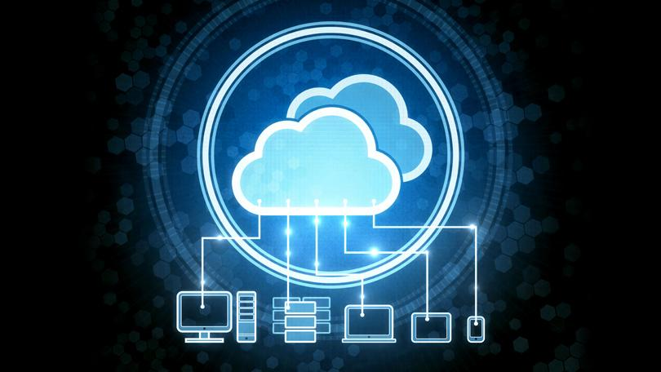
Cloud Computing
Cloud computing allows the users to store personal files, even backup their entire hard disk drive on servers over the Internet.
For businesses, Cloud computing extends IT's capabilities without requiring investment in new infrastructure, training new personnel, or licensing new software.

Slide 38
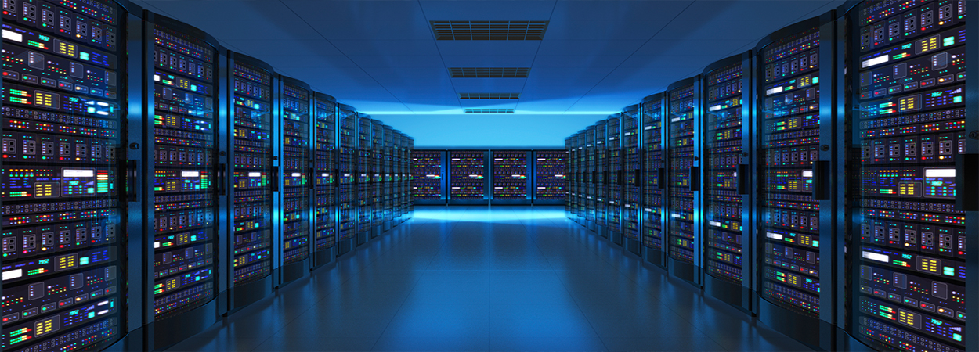
Cont’d…
Cloud computing is possible because of data centers.
A data center is a facility used to house computer systems and associated components
Data centers are typically very expensive to build and maintain. For this reason, only large organizations use privately built data centers to house their data and provide services to users.

Slide 39
Cont’d…
Four types of Clouds:
Public Clouds
Available to the general public through a pay-per-use model or for free.
Private Clouds
Intended for a specific organization or entity such as the government.
Hybrid Clouds
Made up of two or more Cloud types – for example, part custom and part public.
Each part remains a distinctive object but both are connected using the same architecture.
Custom Clouds
Built to meet the needs of a specific industry, such as healthcare or media.
Can be private or public

Slide 40
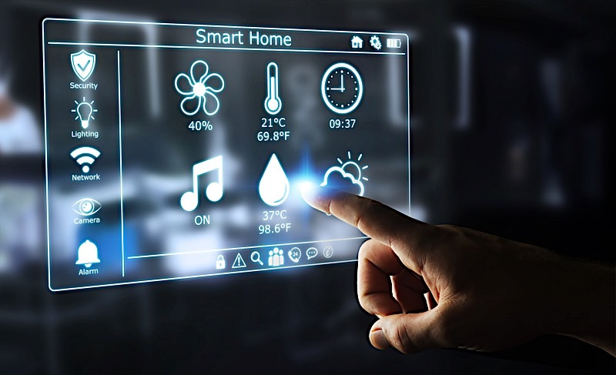
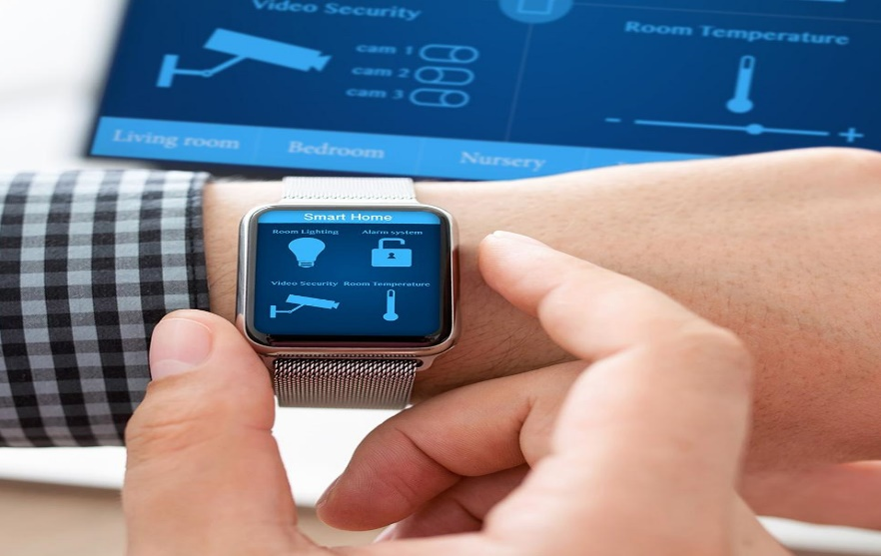
Smart Home Technology
Smart home technology is technology that is integrated into every-day appliances allowing them to interconnect with other devices, making them more ‘smart’ or automated.
Smart home technology will become more of a reality as home networking and high-speed Internet technology becomes more widespread.

Slide 41
Powerline Networking
Powerline Networking uses existing electrical
wiring to connect devices.
By using a standard Powerline Adapter, powerline networking can send data on certain frequencies using the same wiring that delivers electricity.
This saves the cost of installing data cables and without any additional cost to the electrical bill.
It is also useful when wireless access points cannot reach all the devices in the home.

Slide 42
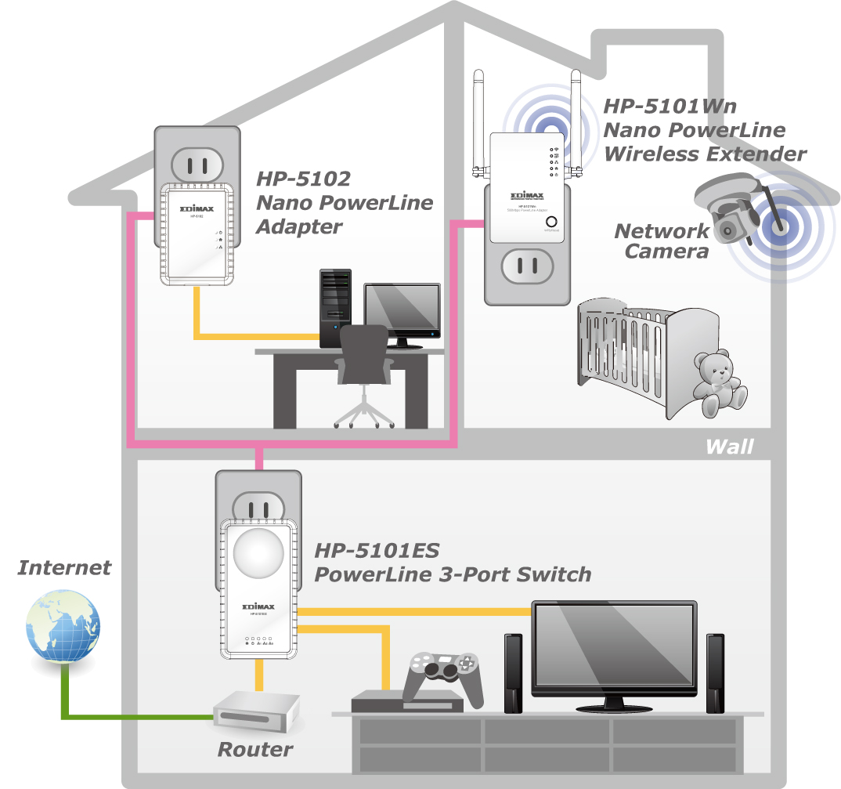
existing electrical
wiring
Powerline Networking

Slide 43
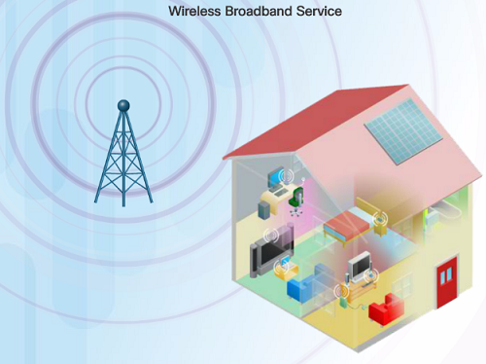
Wireless Broadband
Wireless is another option used to connect homes and small businesses to the internet besides the DSL and cable connection.
More commonly found in rural environments, a Wireless Internet Service Provider (WISP) is an ISP that connects subscribers to designated access points or hotspots.
Uses the same cellular technology used by a smart phone.
An antenna is installed outside the house providing wireless or wired connectivity for devices in the home.

Slide 44
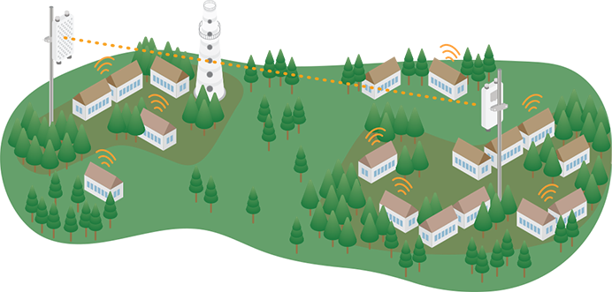
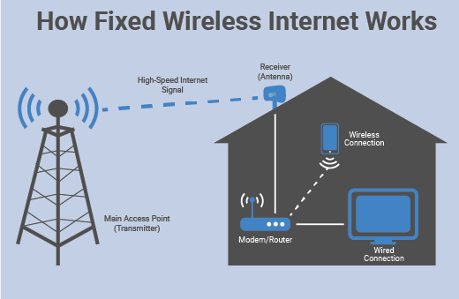

Slide 45
1.7 Issues of Network Management
1. Network Performance
Bandwidth Congestion: Overutilization of network bandwidth can lead to slow performance.
High Latency: Delays in data transmission can affect the performance of real-time applications.
Packet Loss: Data packets not reaching their destination can cause disruptions and data corruption.
Jitter: Variability in packet arrival times can affect voice and video quality.

Slide 46
Cont’d …
2. Network Security
Unauthorized Access: Protecting the network from unauthorized users.
Malware and Viruses: Protecting the network from malicious software.
Data Breaches: Preventing unauthorized access to sensitive data.
Denial of Service (DoS) Attacks: Ensuring the network is resilient against DoS attacks.
3. Network Reliability
Hardware Failures: Handling failures of network hardware components like routers, switches, and cables.
Redundancy and Failover: Implementing redundant systems to ensure continuous operation.
Network Downtime: Minimizing and managing planned and unplanned network outages.

Slide 47
Cont’d …
4. Configuration Management
Configuration Errors: Ensuring network devices are correctly configured to avoid misconfigurations that can cause issues.
Documentation: Keeping accurate records of network configurations, changes, and updates.
Change Management: Carefully planning and documenting changes to the network to prevent disruptions.
5. Network Scalability
Capacity Planning: Planning for future growth to ensure the network can handle increased load.
Upgrading Infrastructure: Updating hardware and software to support new demands and technologies.
Load Balancing: Distributing network traffic efficiently to avoid overloading any single component

Slide 48
Summary
Network Components
Common Types of Networks
Converged Network
Reliable networks
Network Trends
Issues of Network Management

